Slide 1
Streams
Simeon Angelov

Slide 2
Content
Streams in nuts
Operations in streams

Slide 3
Streams in nuts
Wrappers of a data structure (in most cases collections), allowing bulk operations
Streams are unmodifiable
Allows parallel operations
Java.util.steam – supports functional operations on streams (max, min, map, forEach, collectors and etc)
A pipeline of elements, computed on demand
Lambda expression design for operations like filters, collecting and etc …

Slide 4
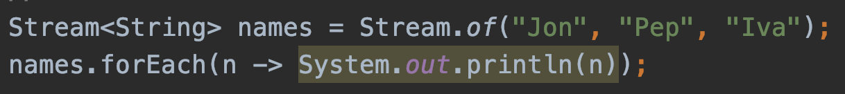
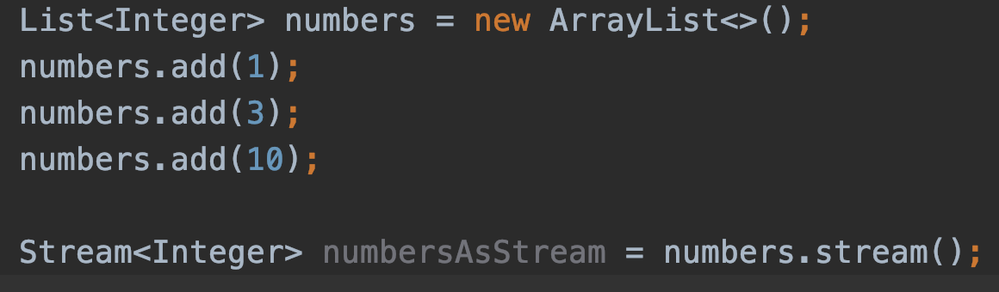
Streams in nuts
Creation of a stream
Using the Stream class
Stream from a collection

Slide 5
Operations in streams
Streams operation types
Terminal operations
Return a type, resulting the computing logic against the stream
Examples:
count()
Min()
Max()
anyMatch()
AllMatch()
Collect()
Intermediate operations
Return a stream itself, so that the computing to continue for further processing
Examples:
Map()
Filter()
Limit()

Slide 6
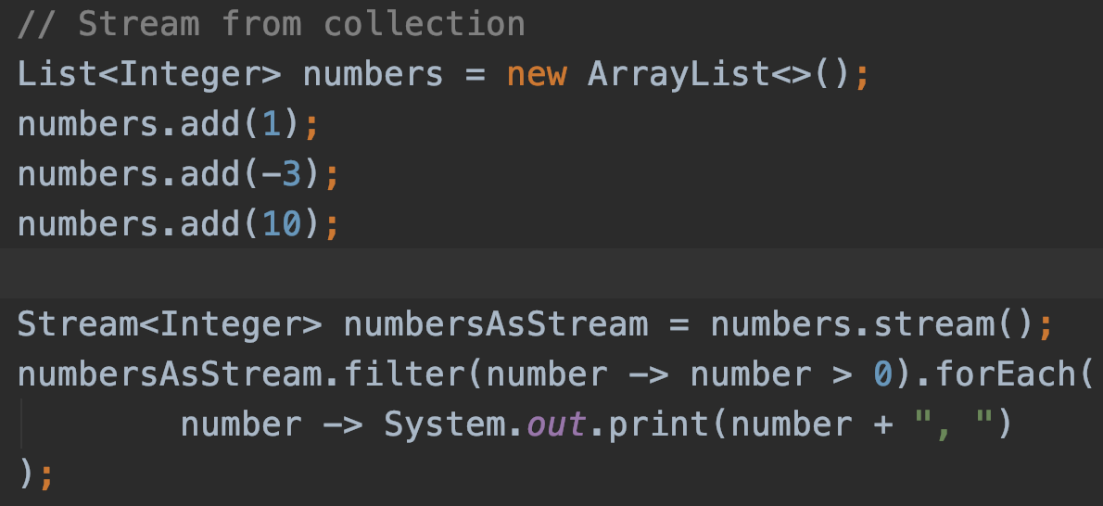
Operations in streams
Filtering of only positive numbers and then prints them

Slide 7
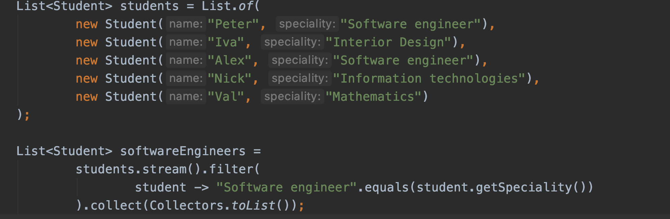
Operations in streams
filter, map, collectors

Slide 8
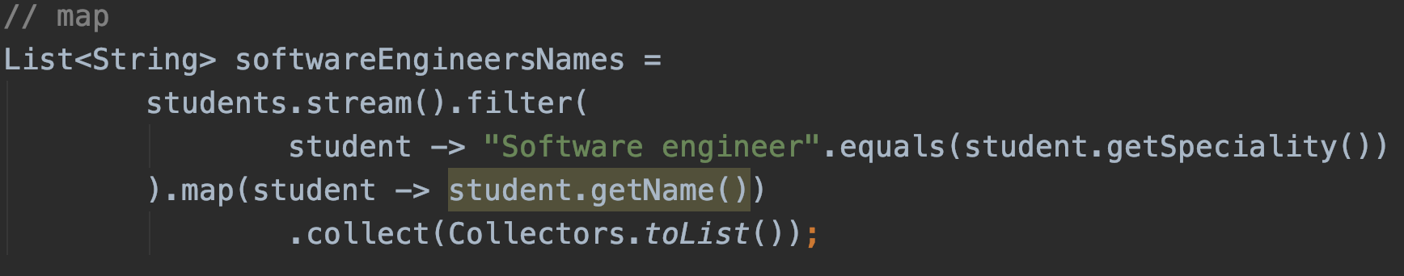
Operations in streams
map() function convert a stream to a stream of same or other type based on a conversion logic
collect(Type of collector) – collects the results and convert it to the type provided

Slide 9
Demo
Streams

Slide 10
Questions?
Notes:
Do you have any questions?

Slide 11
Thank You For Your Time

